Slide 1


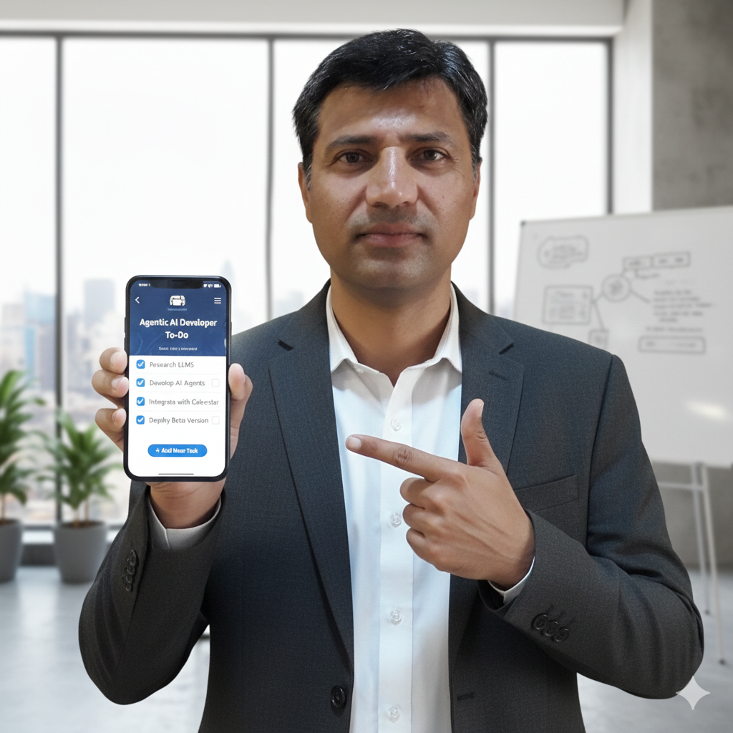
Cloud-Native Todo App
Full-Stack Deployment on OCI OKE
Safdar Ayub
Flow Todo App Hackathon | February 2026
Notes:
Welcome everyone. Today I will present the Cloud-Native Todo App deployment on Oracle Cloud OKE. This project demonstrates a full-stack deployment using modern cloud-native technologies on a free-tier cluster.

Slide 2

Problem & Motivation
Modern apps need cloud deployment to be accessible 24/7
Local development works, but users cannot access localhost
Need to deploy full stack: frontend, backend, database, message broker
Must fit within free-tier cloud resources (budget: $0)
Event-driven architecture requires Kafka + Dapr in Kubernetes
Goal: Deploy a production-grade cloud-native app on OCI OKE free tier
Notes:
The motivation was simple: we had a working local app but needed it accessible 24/7 from anywhere. The challenge was fitting everything - frontend, backend, Kafka, Dapr - into a single free-tier node with only 1 CPU and 8GB RAM.

Slide 3
High-Level Architecture
Frontend
Infrastructure
Next.js 16 + Better Auth
Apache Kafka (KRaft)
Tailwind CSS + Task UI
NGINX Ingress + OCI LB
AI Chat Interface
Neon PostgreSQL (external)
Backend
FastAPI + SQLModel
Platform
Dapr Sidecar (pub/sub)
OCI OKE (me-dubai-1)
Groq AI Integration
1x VM.Standard.E2.1
Helm Charts + kubectl
Notes:
Here is the high-level architecture. The frontend is Next.js with Better Auth. The backend is FastAPI with a Dapr sidecar for pub/sub. Kafka handles event streaming. Everything runs on OCI OKE in Dubai region with Neon PostgreSQL as external database.

Slide 4
Tech Stack Overview
Next.js 16
FastAPI
Better Auth
Frontend + SSR
Python Backend
Authentication
Dapr
Kafka
Neon PG
Pub/Sub Sidecar
Event Streaming
Serverless DB
Helm
OCI OKE
Docker
K8s Packaging
Cloud K8s
Containers
NGINX
Vercel
Groq AI
Ingress Controller
Alt Frontend Host
Chat Assistant
Notes:
Our tech stack includes 12 key technologies. Orange items are application-level: Next.js, FastAPI, Better Auth, Dapr. Blue items are infrastructure: Kafka, Neon PostgreSQL, Helm, OCI OKE. Green items are tooling: Docker, NGINX Ingress, Vercel as alternative frontend host, and Groq AI for the chat assistant.

Slide 5
Challenges & Lessons Learned
Kafka CrashLoop
Apache Kafka KRaft
Bitnami + Confluent images failed
No Zookeeper needed, works on free tier
MFA Token Expiry
Session Refresh
OCI session expires every ~1 hour
oci session authenticate command
Frontend Loading Bug
Split Ingress
Ingress regex rewrite broke JS loading
Separate API + Frontend, no rewrite
Signup Failed
Prefix Match
Path rewrite doubled /api prefix
Pass /api/* as-is to backend
Dapr Events Silent Fail
Env Var Fix
DAPR_ENABLED defaults to False
Added DAPR_ENABLED=true to Helm values
Notes:
We encountered 5 major challenges. Kafka images from Bitnami and Confluent kept crashing - solved by switching to Apache Kafka with KRaft mode. MFA tokens expire hourly. The ingress regex rewrite broke frontend JS loading. Signup failed because the rewrite doubled the API prefix. And Dapr events silently failed because DAPR_ENABLED defaulted to False.

Slide 6
Live Demo URLs
http://139.185.51.243
OKE
Full stack: Frontend + Backend + Dapr + Kafka
https://frontend-blue-six-59.vercel.app
Vercel
Frontend only (HTTPS, CDN-backed)
Both are live 24/7 — app runs on Oracle's cloud servers, not on a laptop
Notes:
The app is live at two URLs. The OKE deployment has the full stack including backend, Dapr, and Kafka at the IP address shown. Vercel hosts just the frontend with HTTPS and CDN. Both run 24/7 - the app does not depend on my laptop being on.

Slide 7
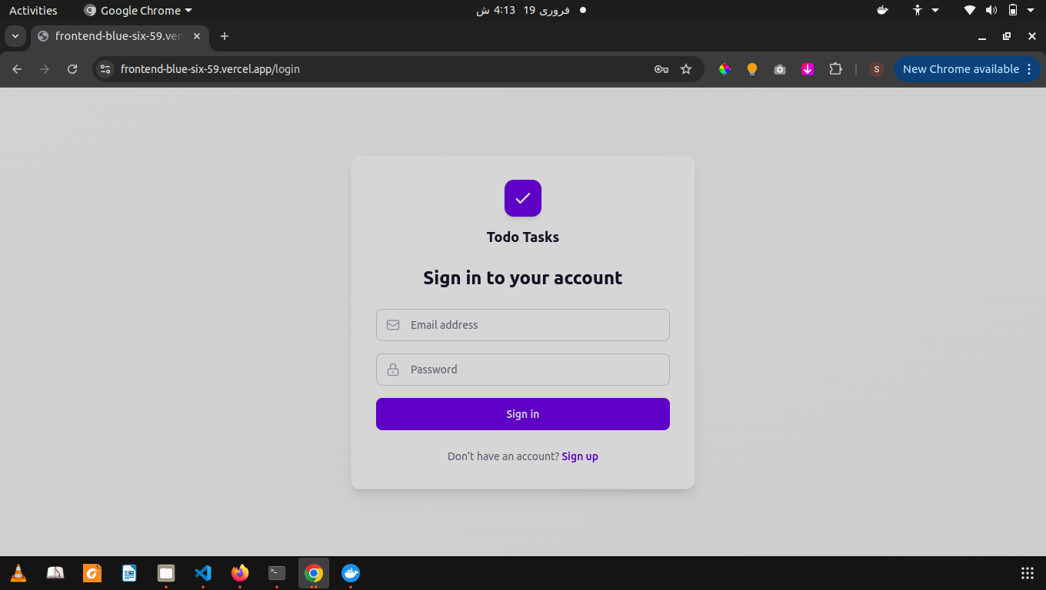
Login Page
Authentication
Better Auth integration
Email + password signup
Session-based auth
JWT token validation
User isolation per account
Notes:
This is the login page. It uses Better Auth for authentication with email and password. Each user gets their own isolated data - no user can see another users tasks.

Slide 8
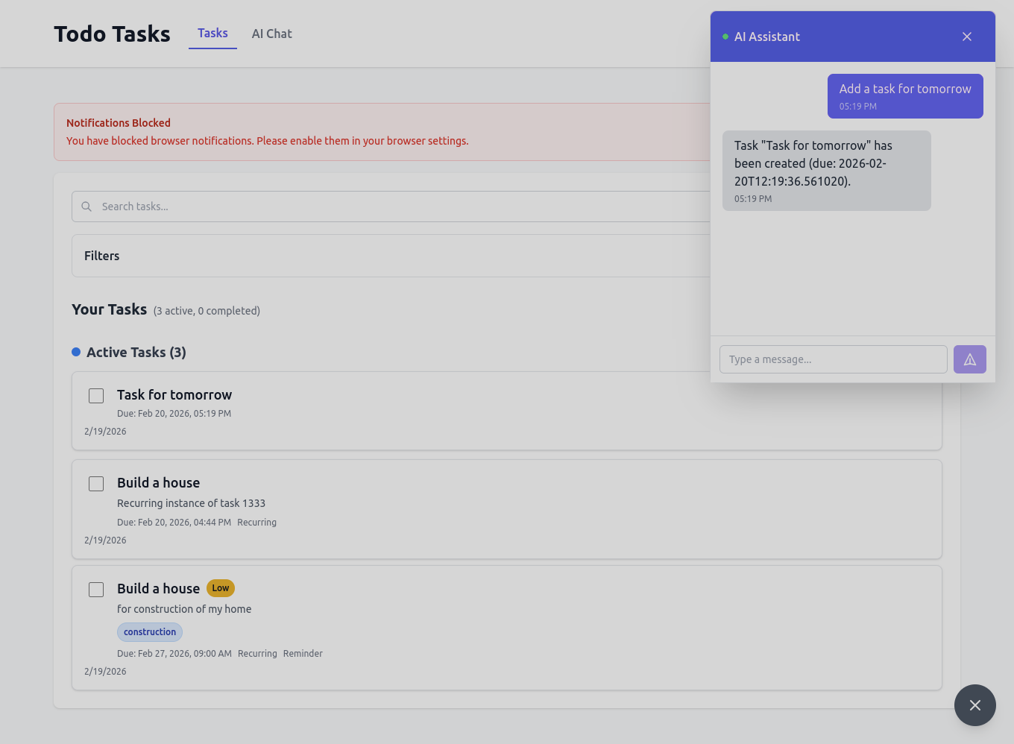
Task Dashboard + AI Chat
Features
Task CRUD operations
Priority + tags + due dates
Recurring tasks
Search and filters
AI chat assistant
Real-time task creation via chat
Notes:
Here is the task dashboard running on OKE. You can see 3 active tasks with priority tags, due dates, and recurring task support. The AI chat assistant on the right can create tasks via natural language - I typed Add a task for tomorrow and it created one automatically.

Slide 9
Cloud Deployment Highlights
$0
1
Total Cost
Node Cluster
OCI Always Free tier
VM.Standard.E2.1 (1 OCPU, 8GB)
5
24/7
Pods Running
Always On
Kafka + Backend (2) + Frontend
Runs without laptop
238m
800Mi
CPU Usage
RAM Usage
Of 1000m budget (24%)
Of 8GB budget (10%)
Notes:
Key deployment highlights: zero cost on OCI free tier, single node cluster, 5 pods running including Kafka with Dapr sidecar on backend. The app runs 24/7. CPU usage is only 24% of budget and RAM is only 10% of the 8GB available.

Slide 10
Event-Driven Architecture
Task events flow from user action to Kafka via Dapr sidecar
User
>
FastAPI
>
Dapr
>
Kafka
Creates Task
Backend API
Sidecar Proxy
Event Broker
Key Design Decisions:
Fire-and-forget pattern (non-blocking event publish)
Dapr sidecar on backend pod only (not frontend)
Kafka KRaft mode eliminates Zookeeper dependency
Topic auto-creation enabled for simplicity
Notes:
The event flow is: user creates a task, FastAPI backend processes it, Dapr sidecar publishes the event, and Kafka stores it in the todo-events topic. This is a fire-and-forget pattern so it does not slow down the API response. Kafka uses KRaft mode which eliminates the need for Zookeeper.

Slide 11
Resource Usage & Free-Tier Fit
All components fit within a single 1 OCPU / 8GB RAM node
Component | CPU Request | CPU Limit | RAM Request | RAM Limit
Backend | 64m | 250m | 128Mi | 384Mi
Frontend | 64m | 250m | 128Mi | 384Mi
Kafka (KRaft) | 100m | 500m | 512Mi | 1Gi
Dapr Sidecar | 10m | 100m | 32Mi | 64Mi
NGINX Ingress | 50m | 200m | 64Mi | 128Mi
TOTAL | 288m | 1300m | 864Mi | 2.0Gi
Notes:
This table shows resource allocation for each component. Total CPU requests are 288m out of 1000m available (29%), and RAM requests are 864Mi out of 8GB (11%). We have plenty of headroom on the free-tier node.

Slide 12
Verification Results
PASS
kubectl get pods - all Running
PASS
kubectl get svc - correct ports (7860, 80, 9092)
PASS
kubectl get ingress - LB IP 139.185.51.243 assigned
PASS
curl /api/v1/auth/session - backend responds (HTTP 200)
PASS
curl / - frontend loads (HTTP 200)
PASS
Browser signup + login - authentication works
PASS
Task create/edit/delete - CRUD operations verified
PASS
Dapr event publish to Kafka - event pipeline working
PASS
Resource budget - 238m CPU / 800Mi within 1 OCPU / 8GB
33/33 tasks completed across all 6 phases
Notes:
All 9 verification checks pass. Every pod is running, services have correct ports, ingress has the LoadBalancer IP assigned, both frontend and backend respond to HTTP requests, authentication works end-to-end, CRUD operations are verified, Dapr events publish to Kafka, and resource usage fits within budget. 33 out of 33 tasks completed.

Slide 13
Future Work
1
HTTPS / TLS
Install cert-manager + Let's Encrypt for secure connections
2
Custom Domain
Buy a domain and point DNS to the LoadBalancer IP
3
CI/CD Pipeline
GitHub Actions for automated build, push, and deploy
4
Monitoring
Install metrics-server, Prometheus, and Grafana dashboards
5
Kafka Consumers
Add event consumers for notifications, analytics, audit logs
Notes:
For future improvements: First, add HTTPS with cert-manager and Lets Encrypt. Second, buy a custom domain. Third, set up CI/CD with GitHub Actions. Fourth, add monitoring with Prometheus and Grafana. Fifth, implement Kafka consumers for notifications and analytics.

Slide 14
Thank You
Questions?
Safdar Ayub
OKE: http://139.185.51.243
Vercel: https://frontend-blue-six-59.vercel.app
Notes:
Thank you for your attention. The app is live at both URLs shown. I am happy to take any questions about the architecture, deployment process, or challenges we solved.

